Slide 1
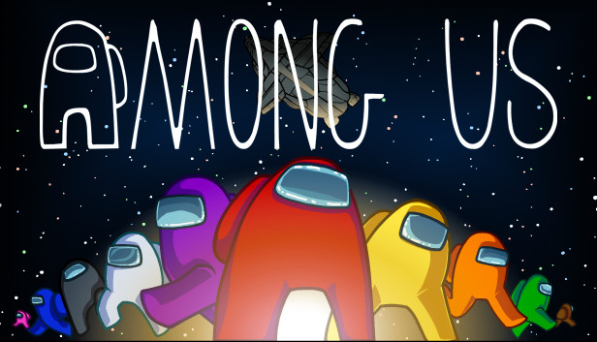
Presented by Hugo Mlodecki

Slide 2
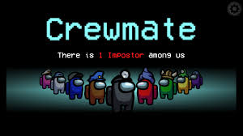
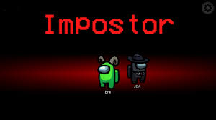
Among us rules
Crewmates VS Impostors
Find and eliminate all impostors
Complete all tasks
Kill enough crewmate
Sabotage count down

Slide 3
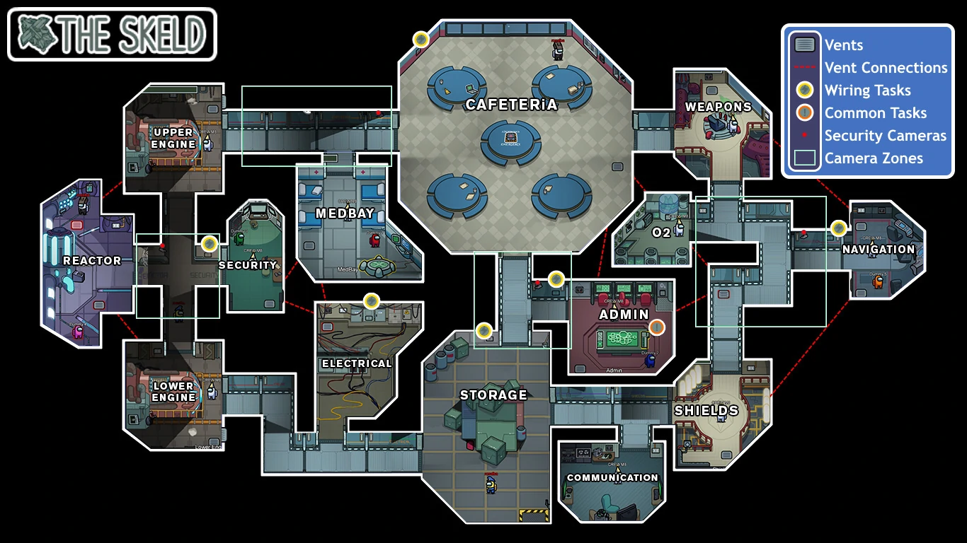

Slide 4
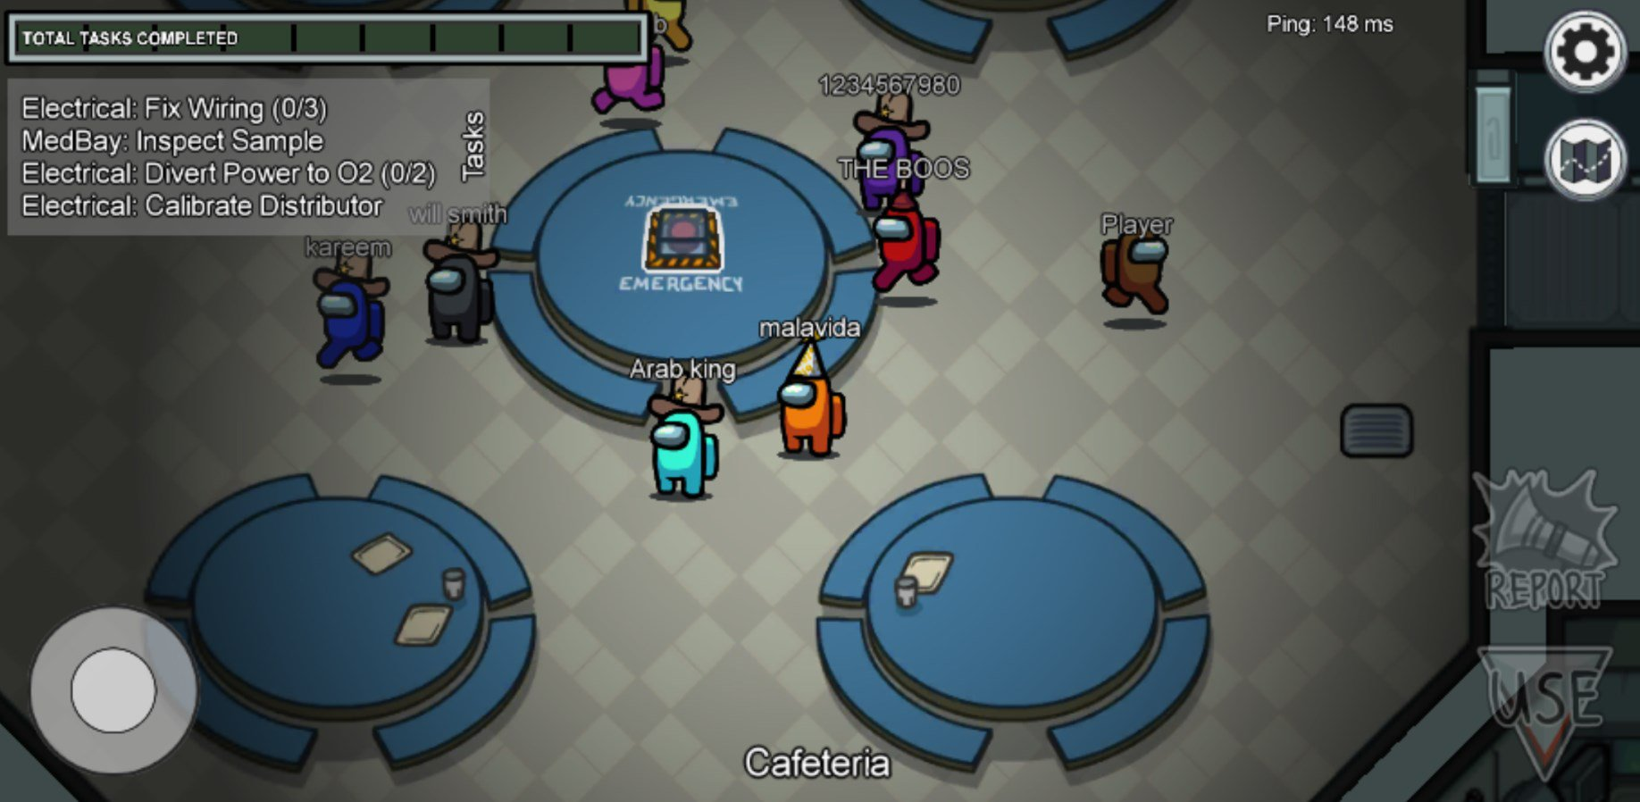

Slide 5
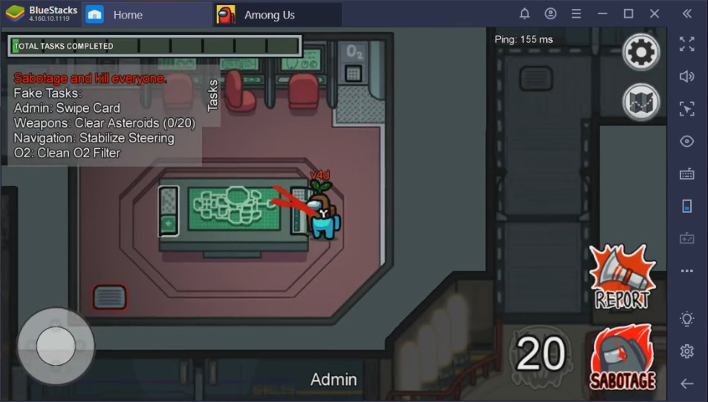

Slide 6
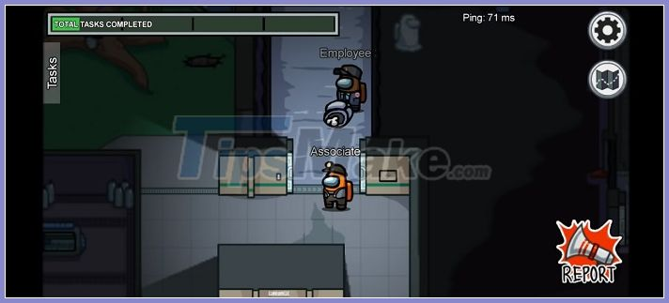

Slide 7
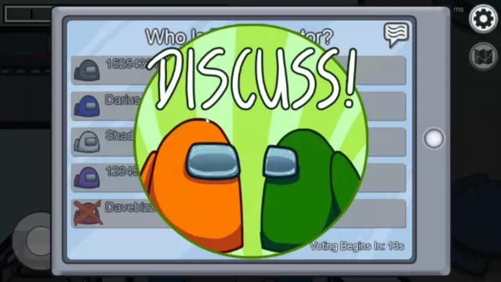

Slide 8
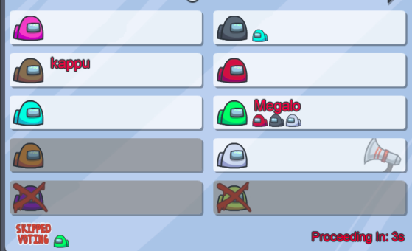

Slide 9
The game’s rules
Crewmates VS Impostors
Find and eliminate all impostors
Complete all tasks
Kill enough crewmate
Sabotage count down

Slide 10
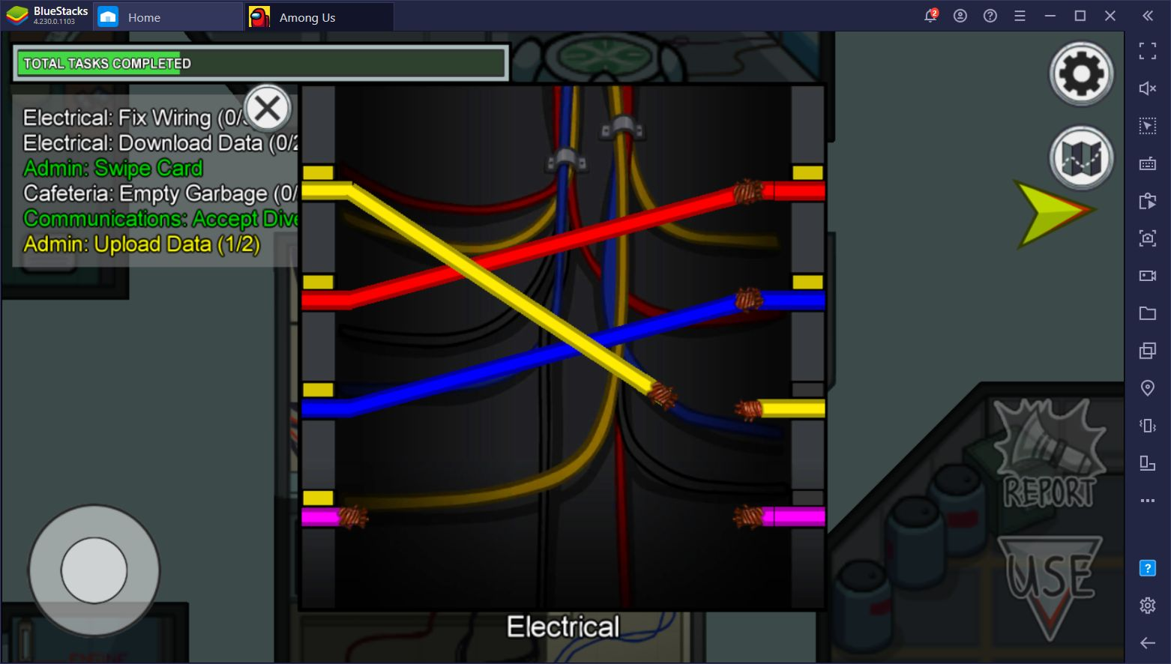
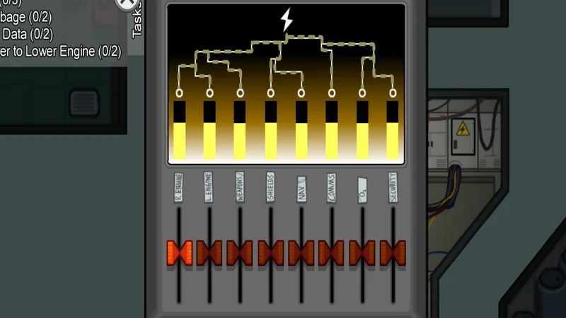
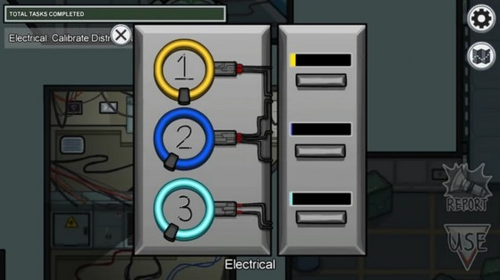
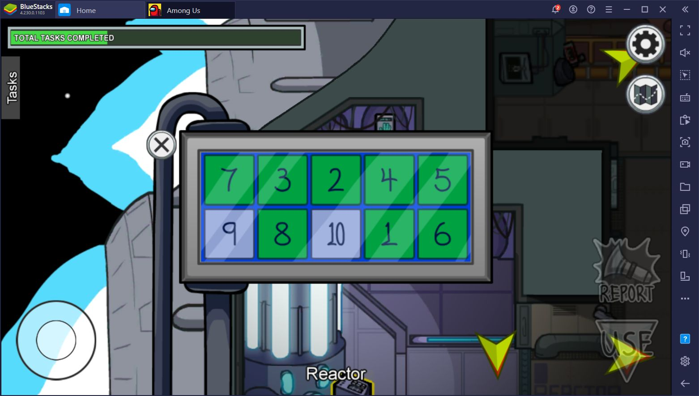

Slide 11
The game’s rules
Crewmates VS Impostors
Find and eliminate all impostors
Complete all tasks
Kill enough crewmate
Sabotage count down

Slide 12
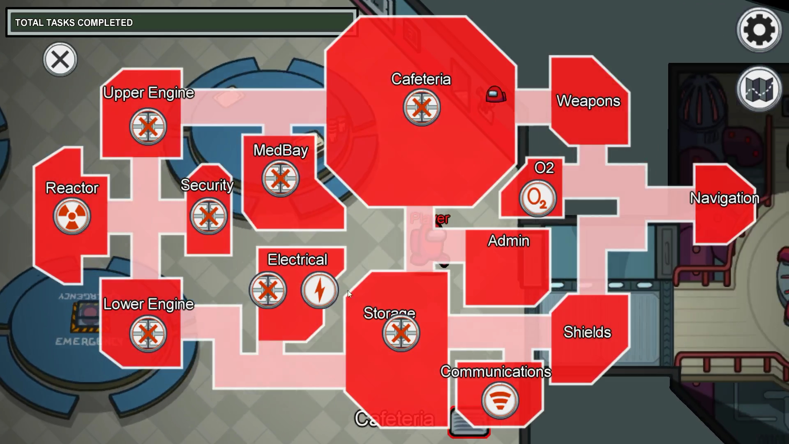

Slide 13
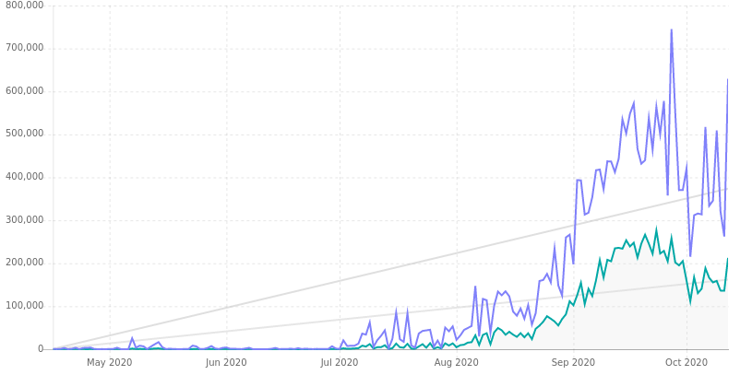
Popularity
Released in 2018. Only 30 to 50 players.
July 2020 Twitch streamer Sodapoppin.
Among Us average/peak daily viewers
https://sullygnome.com/game/among_Us/180/summary

Slide 14
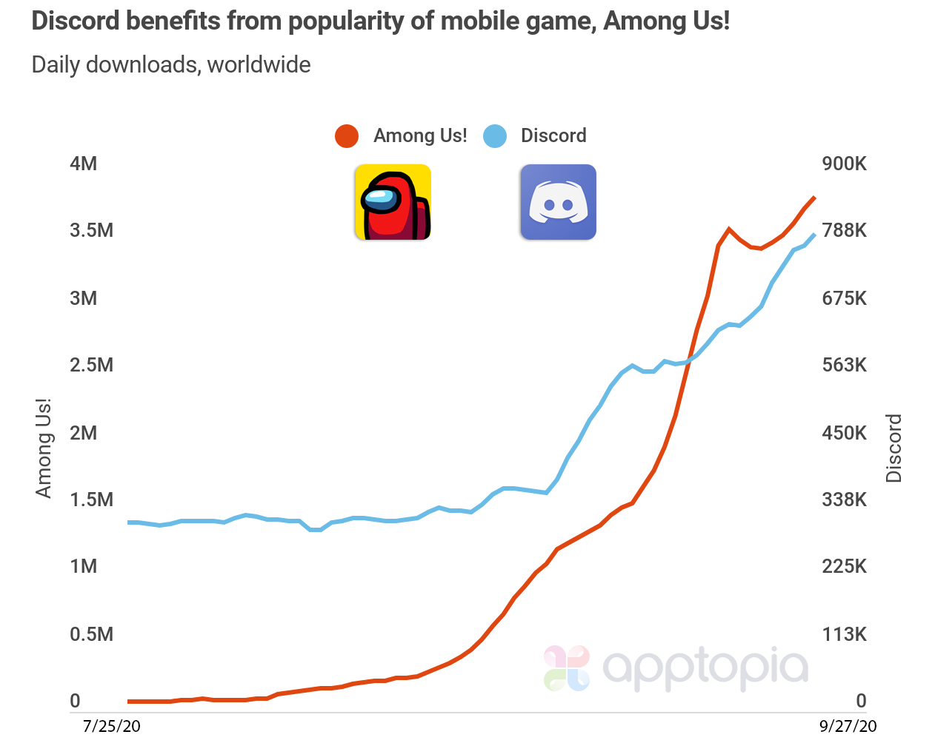
Discord benefits

Slide 15
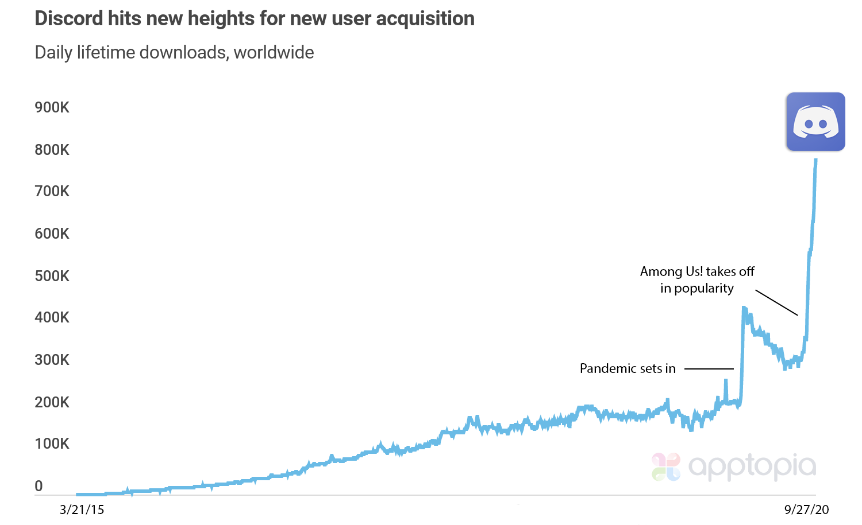
Discord benefits

